Slide 1

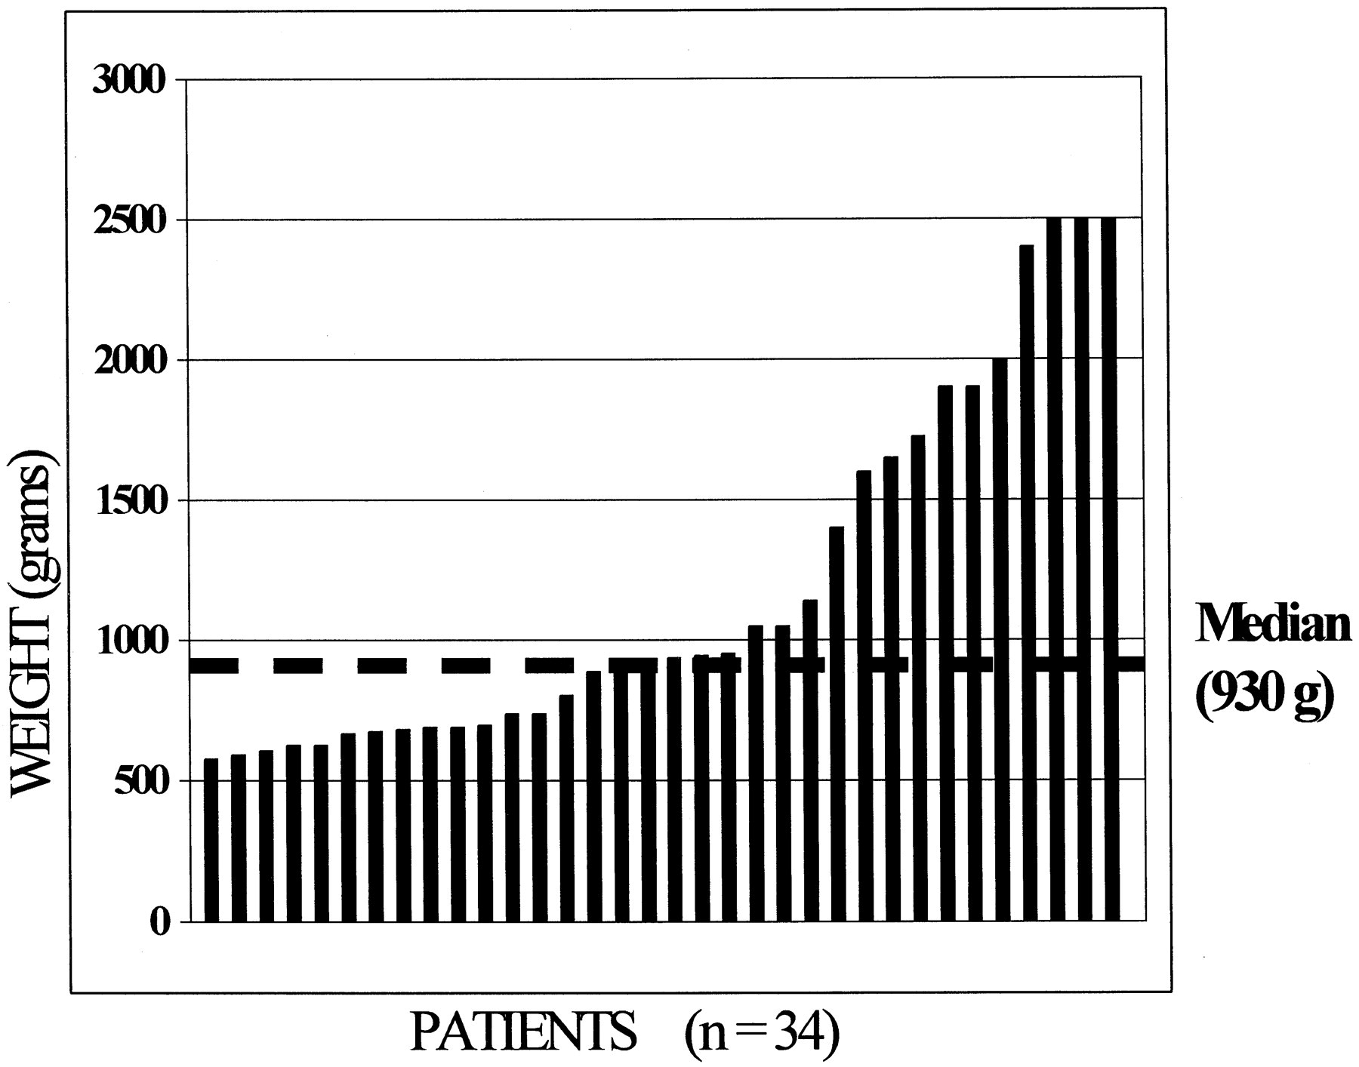
From: Video-Assisted Thoracoscopic Surgery for Patent Ductus Arteriosus in Low Birth Weight Neonates and Infants
Pediatrics. 1999;104(2):227-230. doi:10.1542/peds.104.2.227
Figure Legend:
Range of patient weight at time of surgery.
Date of Download: 4/17/2024
Copyright © 2024 American Academy of Pediatrics. All rights reserved.

Slide 2
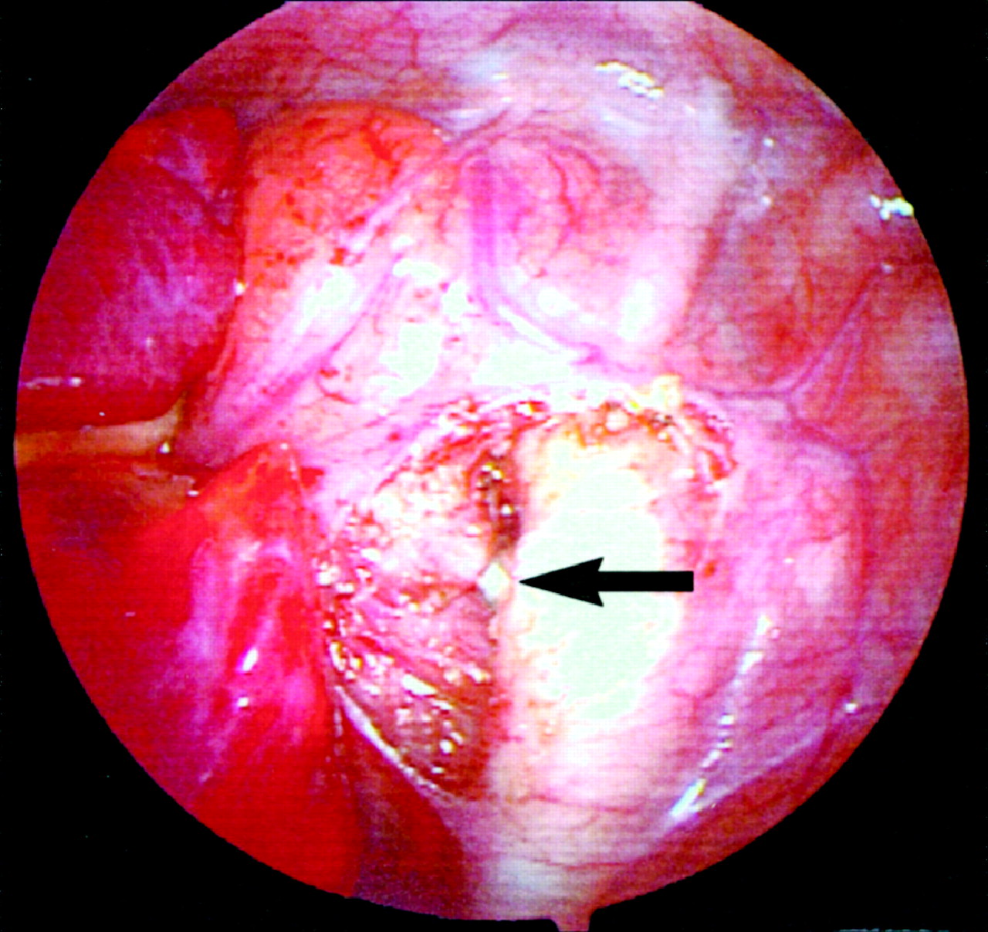
From: Video-Assisted Thoracoscopic Surgery for Patent Ductus Arteriosus in Low Birth Weight Neonates and Infants
Pediatrics. 1999;104(2):227-230. doi:10.1542/peds.104.2.227
Figure Legend:
An endoscopic vascular clip is placed to interrupt the PDA. The arrow points to the clip on the PDA.
Date of Download: 4/17/2024
Copyright © 2024 American Academy of Pediatrics. All rights reserved.

Slide 3
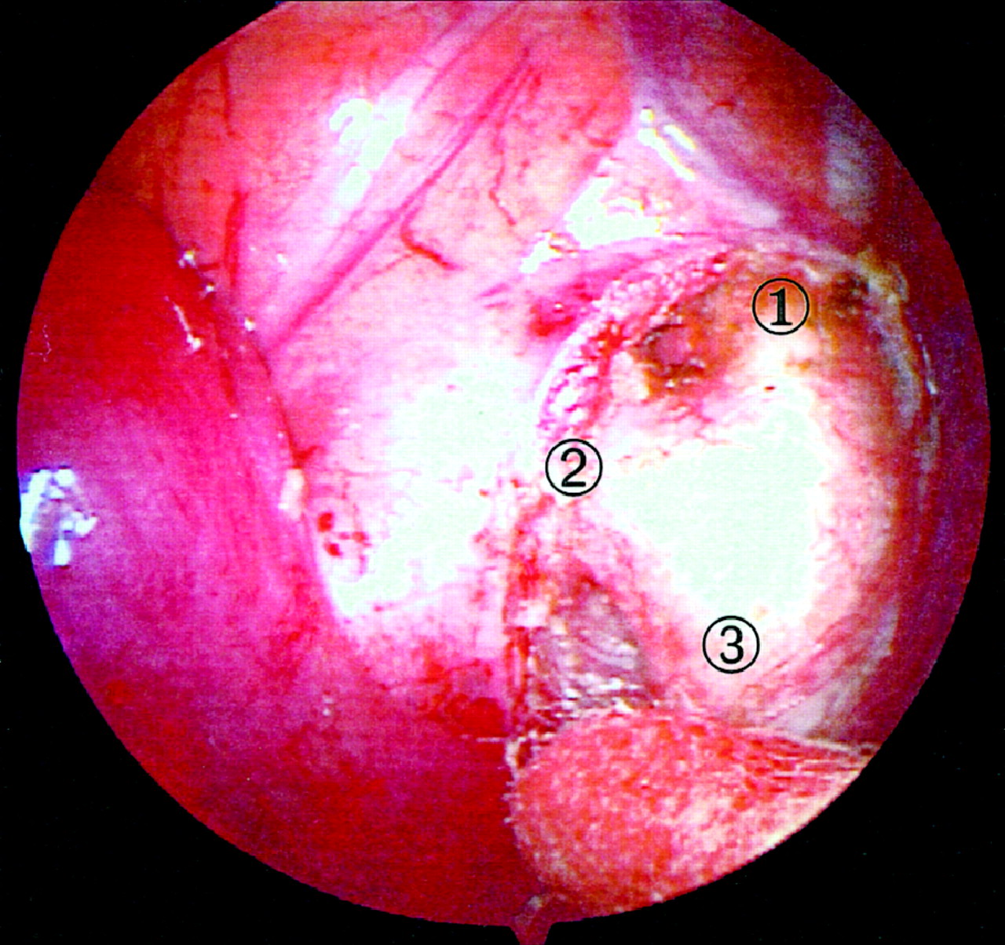
From: Video-Assisted Thoracoscopic Surgery for Patent Ductus Arteriosus in Low Birth Weight Neonates and Infants
Pediatrics. 1999;104(2):227-230. doi:10.1542/peds.104.2.227
Figure Legend:
Endoscopic view of PDA. One indicates aortic isthmus (descending thoracic aorta between the left subclavian artery and the PDA). Two indicates PDA. Three indicates descending thoracic aorta inferior to the PDA. The tip of a cotton swab is seen resting on the descending thoracic aorta.
Date of Download: 4/17/2024
Copyright © 2024 American Academy of Pediatrics. All rights reserved.

