Slide 1

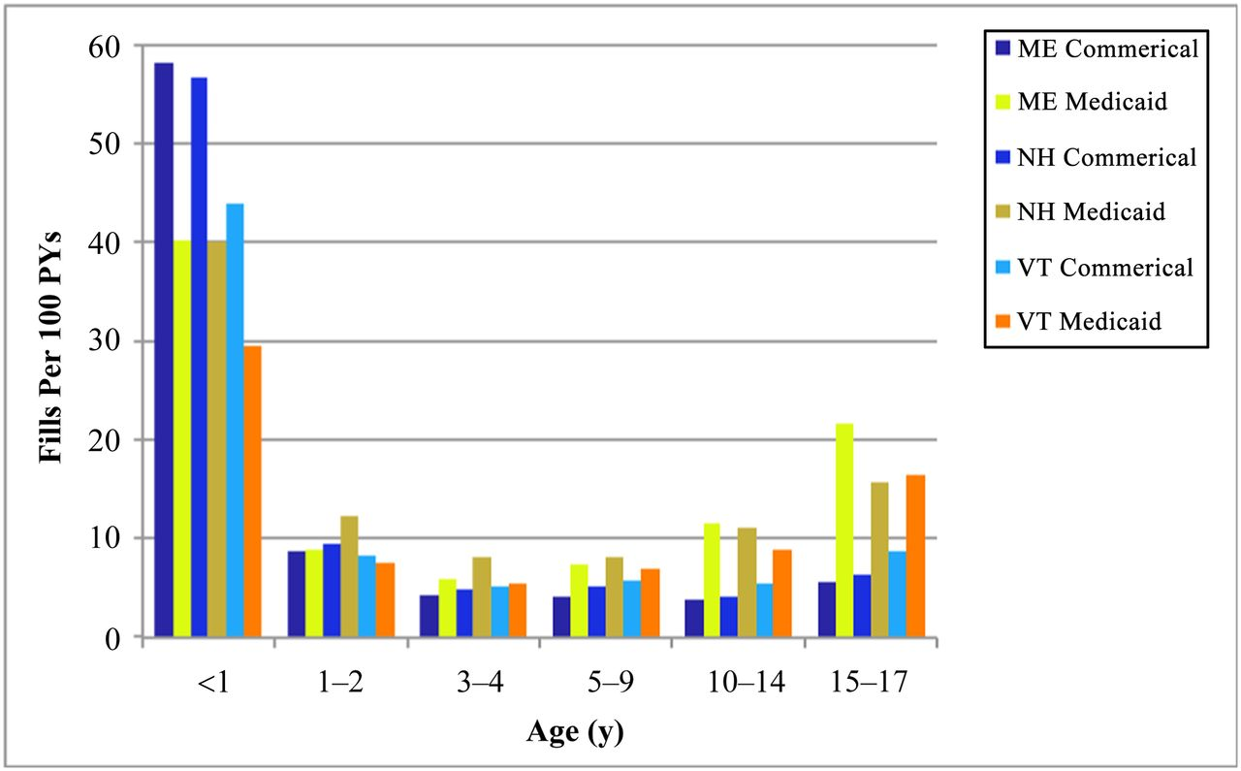
From: Small Geographic Area Variations in Prescription Drug Use
Pediatrics. 2014;134(3):563-570. doi:10.1542/peds.2013-4250
Figure Legend:
Antacid prescription fills per 100 PYs according to age group and state-specific payer type. The graphic portrays paradoxically higher rates of fills among commercially insured infants (compared with Medicaid-insured infants).
Date of Download: 4/17/2024
Copyright © 2024 American Academy of Pediatrics. All rights reserved.

Slide 2
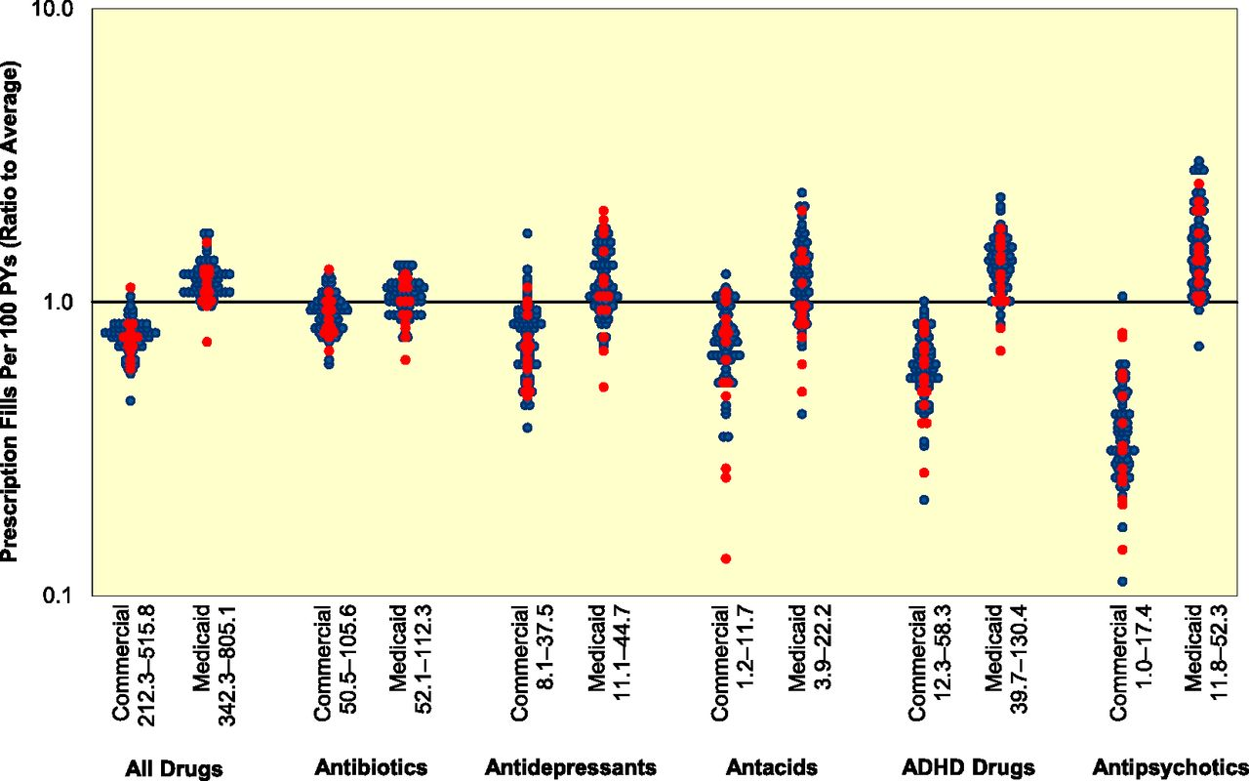
From: Small Geographic Area Variations in Prescription Drug Use
Pediatrics. 2014;134(3):563-570. doi:10.1542/peds.2013-4250
Figure Legend:
Prescription fill rates in HSAs plotted as the ratio of observed use (area-adjusted rate) to expected use (overall northern New England rate), stratified by payer. Red dots are small HSAs (14 of 69); minimum number of children per area is 346 commercial and 525 Medicaid. Rate range is in legend.
Date of Download: 4/17/2024
Copyright © 2024 American Academy of Pediatrics. All rights reserved.

